Slide 1
House Price Predicting
ZHANG TIECHEN

Slide 2
Introduction
Predicting the residential house price can guide real estate agents during the decision making and pricing process, therefore assistant their customers to find the best selling price for their houses.
Zillow uses the prediction of the house price to provide guidance to its online seller and buyer.
Airbnb leverages the house price prediction to inform their hosts to better pricing their places.
The objective of this project is to predict the final price of a house given 79 explanatory variables that describe almost all aspects of a house in Ames, Iowa.

Slide 3
Methodology
Exploratory data analysis
Feature preprocessing
Benchmark modeling
Model improvement
Notes:
Exploratory data analysis – Understanding the type of features in the dataset, how much missing values of different features, how many outliers are existed and whether specific features are skewed, are crucial in order to create a good model in the end.
Feature preprocessing – Preprocess the data using the insights obtained from the exploratory data analysis, potentially including feature transformation, data type transformation, outlier detection and imputing missing values.
Benchmark modeling – Creating a model using a standard technique for the problem in order to set up a benchmark for the future modeling improvement.
Model improvement – Tuning model parameters to improve the performance of individual model and stacking individual models to provide final submission using ensemble learning technique.

Slide 4
Data Source
The training dataset is mixed with categorical and numerical features as well as some missing values.
Specifically, there are 1460 observations, each with 79 features including the sale price of the house.
The test dataset has 1461 observations, each with 78 features.
Our task is to fill the sale price of the test dataset using the model trained from the training dataset.

Slide 5
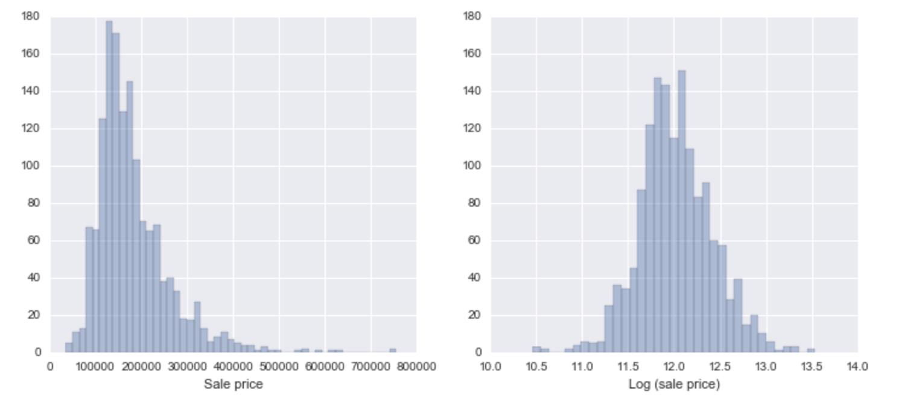
Exploratory data analysis
Figure 1: The histograms of the house sale price. (left) Original data; (right) Log transformed data.
Notes:
The training dataset is mixed with categorical and numerical features as well as some missing values. Specifically, there are 1460 observations, each with 79 features including the sale price of the house. The test dataset has 1461 observations, each with 78 features. Our task is to fill the sale price of the test dataset using the model trained from the training dataset. The histogram of the house price is shown in Figure 1, which shows that it is skewed. Thus, the log transformation needs to be performed in order to normalize it and this is the reason why we need to use the RMSLE as our evaluation metric.

Slide 6
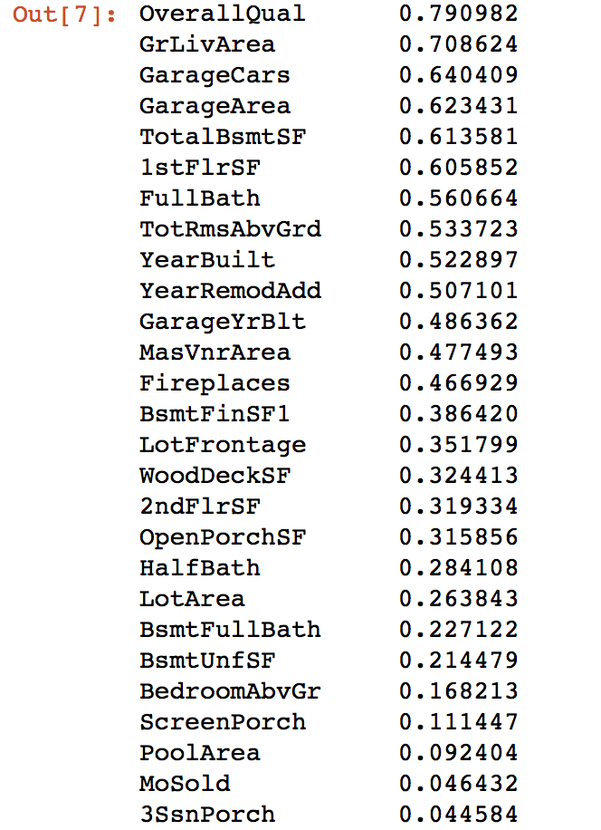
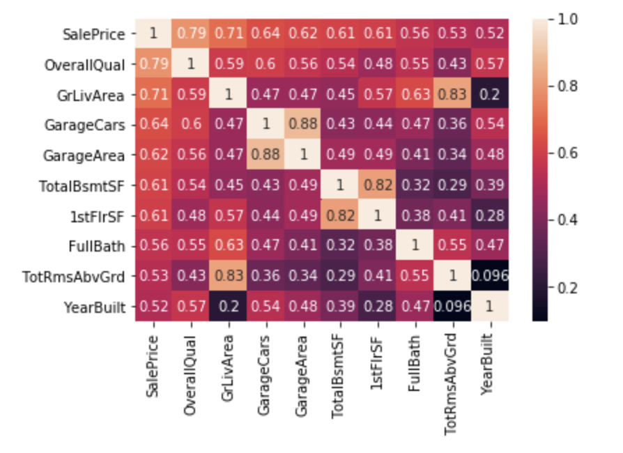
Exploratory data analysis
Figure 2: The correlation coefficients between some variables and the sale price
Figure 3: The correlation matrix between different numerical variables.
Notes:
Figure 2 shows the correlation matrix between the numerical variables and the house sale. There are several variables that are strongly correlated with the house price shown in Figure 2. I also explore the top six variables that are highly correlated with the sale price in Figure 3.

Slide 7
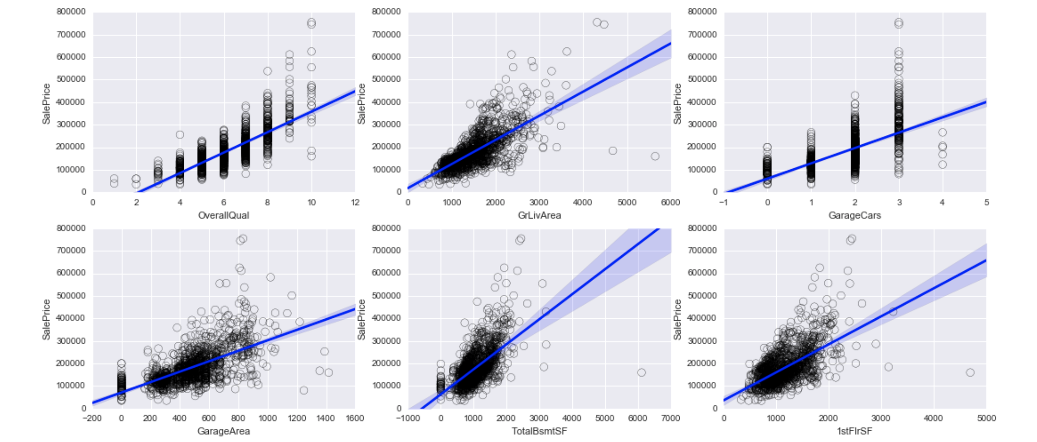
Exploratory data analysis
Figure 4: The scatter plot of the top 6 strongly correlated variables with the house price. The regression curve is shown in blue.

Slide 8
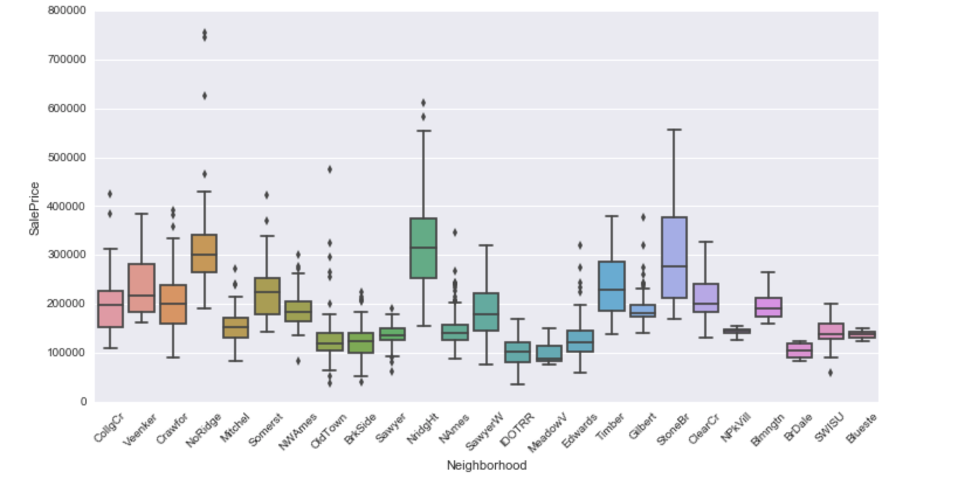
Exploratory data analysis
Figure 5: Boxplot of sale price in different neighborhood.
Notes:
To give an example of the categorical variable, the boxplot between the neighborhood and the sale price is shown in Figure 5. We can observe a clear pattern that the neighborhood feature can greatly affect the house price. In order to include all categorical features into our machine learning model, the categorical variables can be transformed into some dummy variables, which takes the value 0 or 1 to indicate the absence or presence of some categorical effect.

Slide 9
Clean Data
Outliers deletion： Any predictions from the benchmark that differ more than $12000 than the actual house price are labeled as outliers.
Feature selection：delete features with high number of missing values.
Log transform skewed features： All features that have a skewness larger than 0.75 are log transformed.
Handle categorical features： The categorical features are handled by the pandas get dummies function that converts categorical variables into dummy or indicator variables.
Notes:
• Outliers deletion Any predictions from the benchmark that differ more than $12000 than the actual house price are labeled as outliers. The threshold selected here is somewhat arbitrary but this approach actually increases both the local score and the public score a little bit in my explorations. All outliers are deleted from the training dataset for the final submission. This • Feature selection
The feature selection approach I adopted here is a very simple and naïve one: delete features with high number of missing values. The categorical variables with the largest number of missing values are Alley, FirePlaceQu, PoolQC, Fence and MiscFeature. In the data exploration analysis, there are some features that are highly correlated with the sale price. We may treat some of these features as redundant variables and delete them from the training dataset. However, previous investigation shows that this will leads to a small decrease in both the local score and public score. There are many other useful and advanced feature selection techniques, such as the boruta method (https://m2.icm.edu.pl/boruta/). A detail discussion of feature selection techniques is beyond the scope of this project.
• Log transform skewed features All features that have a skewness larger than 0.75 are log transformed.
• Handle categorical features The categorical features are handled by the pandas get_dummies function that converts categorical variables into dummy or indicator variables. See pandas documentation for more details (http://pandas.pydata.org/pandas-docs/stable/generated/pandas.get_dummies.html).
\

Slide 10
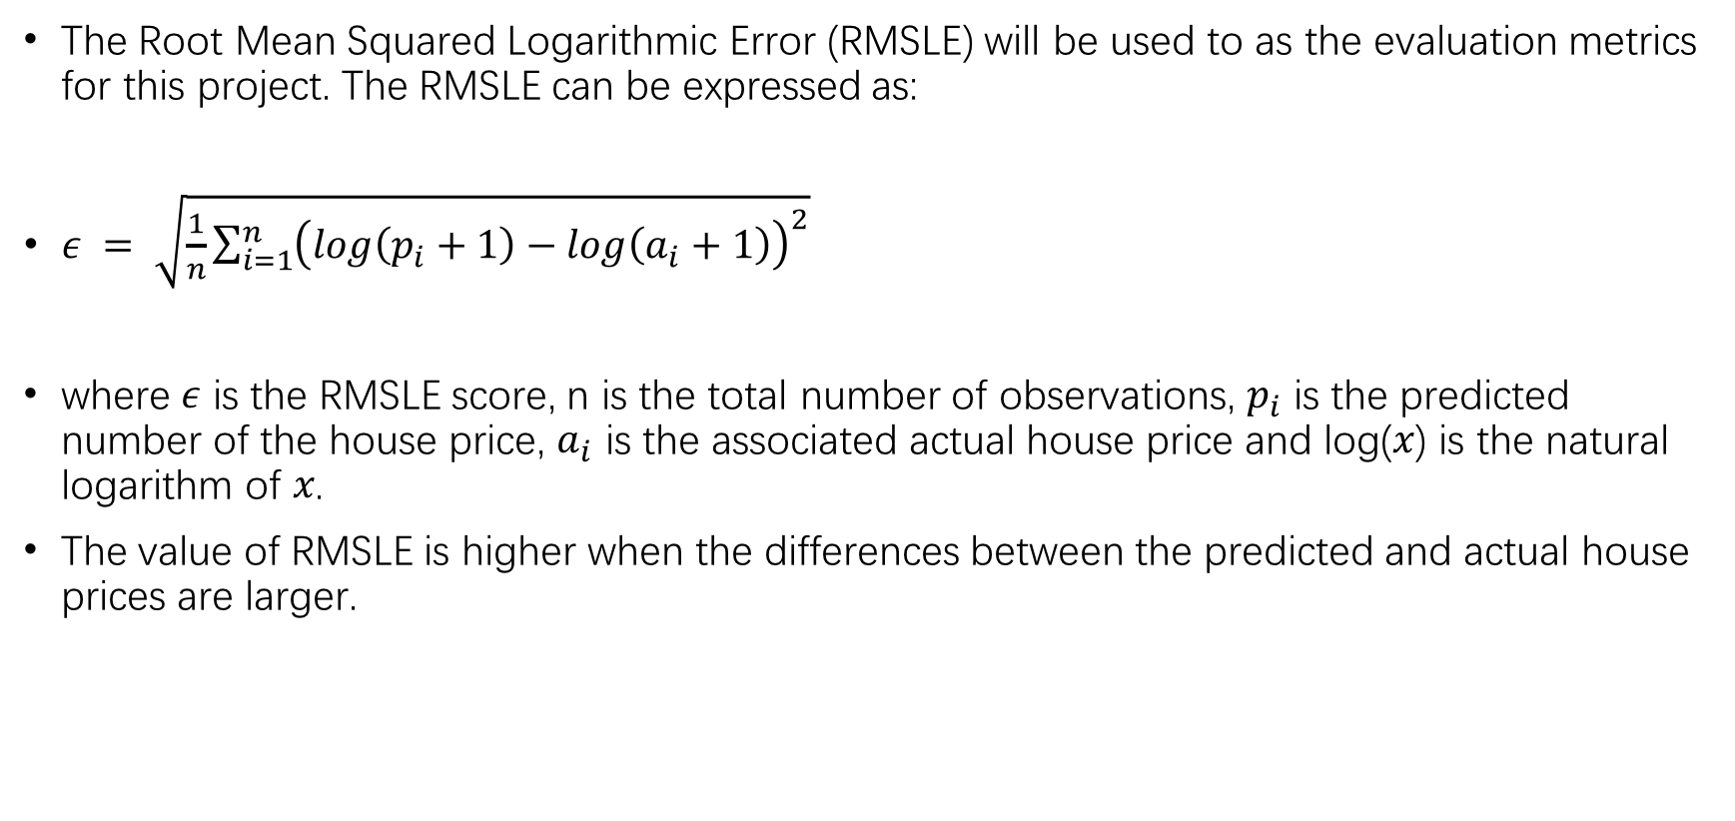
Metrics
The Root Mean Squared Logarithmic Error (RMSLE) will be used to as the evaluation metrics for this project. The RMSLE can be expressed as:
$ε = \sqrt{\frac{1}{n}\sum_{i=1}^{n}{{\left(\log\left(p_{i}+1\right)−log\left(a_{i}+1\right)\right)}^{2}}}$
where 𝜖 is the RMSLE score, n is the total number of observations, $p_{i}$ is the predicted number of the house price, $a_{i}$ is the associated actual house price and log(𝑥) is the natural logarithm of 𝑥.
The value of RMSLE is higher when the differences between the predicted and actual house prices are larger.
Notes:
What is RMSLE

Slide 11
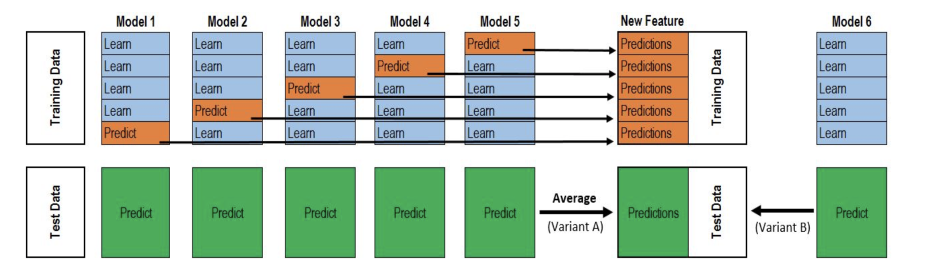
Algorithms and Techniques
Figure 6: An illustration of stacking approach.
The basic idea of stacking is to use another model or “stacker” to combine all previous model predictions in order to reduce the generalization error.
An illustration of a 2 level 5 folds stacking approach is shown in Figure 6.
In each iteration, each base model will be trained using 4 folds and predict on the hold out fold.
At the same time, each base model also need to provide a prediction on the entire test dataset. After the iteration over all folds, we will have the prediction of the entire training dataset for each model and 5 copies of the prediction of the entire test dataset for each model.
Finally, we train second level model, or stacker, using the prediction in the training dataset as new features and use the average of the 5 copies of the test dataset predictions as the test input for the trained model to provide the final prediction.
Notes:
Given one of the purposes of this project is to explore advanced regression techniques, I am going to use the ensemble learning technique to achieve better evaluation score. The ensemble learning techniques aim to learn a weighted combination of the base models and it sometimes called a committee method (Murphy, 2012). The technique we implemented in this project is called stacking. Stacking, which stands for “stacked generalization”, was introduced by Wolpert (1992). The data science competition participants use this method extensively in order to win the competition. One well known example is the Netflix prize competition winning solution, BellKor’s Pragmatic Chaos.
The basic idea of stacking is to use another model or “stacker” to combine all previous model predictions in order to reduce the generalization error. An illustration of a 2 level 5 folds stacking approach is shown in Figure 6. First, the training dataset need to be split into 5 folds. Second, we iterate over this 5 folds training dataset. In each iteration, each base model will be trained using 4 folds and predict on the hold out fold. At the same time, each base model also need to provide a prediction on the entire test dataset. After the iteration over all folds, we will have the prediction of the entire training dataset for each model and 5 copies of the prediction of the entire test dataset for each model. Finally, we train second level model, or stacker, using the prediction in the training dataset as new features and use the average of the 5 copies of the test dataset predictions as the test input for the trained model to provide the final prediction.

Slide 12
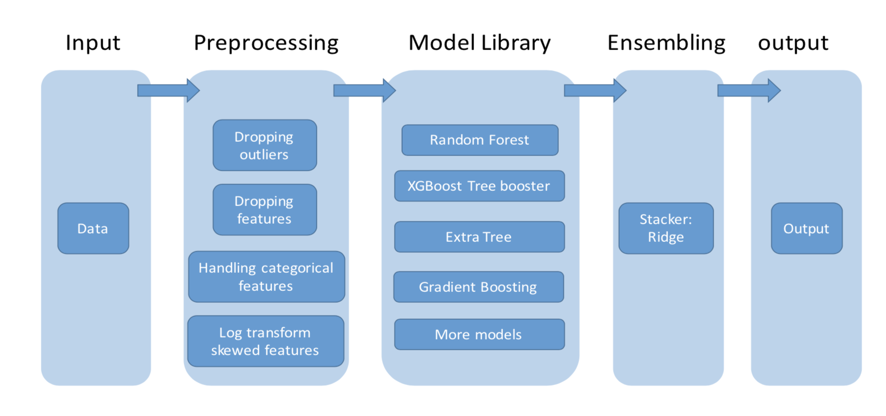
Methodology
Figure 7: Flowchart of the modeling approach.
Notes:
The overall methodology and modeling approach can be summarized using the flowchart shown in Figure 7. The details of the approach will be discussed in the following subsections.

Slide 13
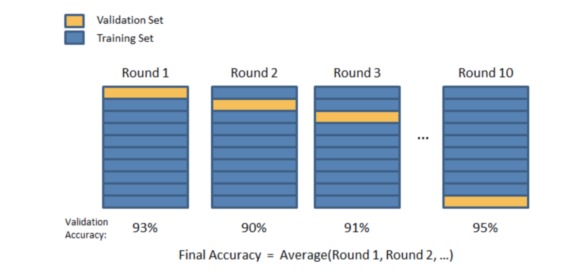
K fold cross validation technique
Figure 8: K fold cross validation technique for model validation
First split data into k subsets of equal size.
Then use each subset in turn for testing, the remainer for training. Repeat this step for k times for each subsets. After k iterations, we calculate the accuracy performance metric of all examples to evaluate the “general performance” of an algorithm.
If we just split training dataset into two sets, there will be a problem. One algorithm may work well on this particular split of training and testng dataset. So we need evaluate the classifier's performance by using k fold cross validation method.
Notes:
The random sub-sampling cross-validation method [4] was used to test the accuracy of the predictive models. This form of validation runs a model multiple times in randomized simulation environments and averages the results. The primary objective of validation was to confirm that the predicted house prices were correlated with the factors selected.
How to explain?

Slide 14
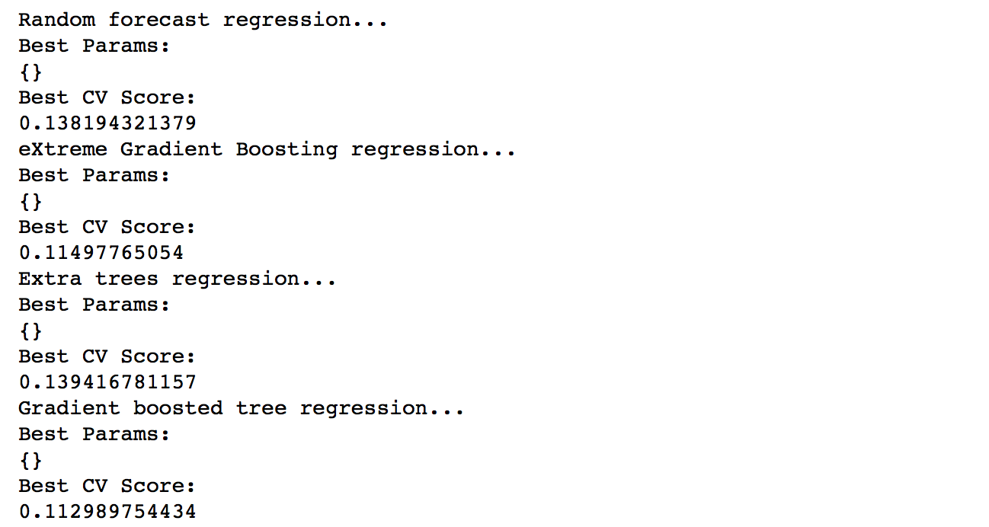
Single model
I trained and tuned 4 base model for my first level
Figure 9: The local cross validation score with default scikit-learn parameter values.
Notes:
Before applying the ensemble learning method, I trained and tuned 4 base model including Random Forest regressor, Extra Trees regressor, Gradient Boosting regressor, Extreme Gradient Boosting regressor.
At the beginning of the ensembling implementation, I use only 4 base models to form my model library, including Random Forest regressor, Extra Trees regressor, Gradient Boosting regressor, Extreme Gradient Boosting regressor. And I use the Ridge Regression as my second level model. The idea of the stacking approach is to use the predictions from the first level model as the new features for the second level model and make prediction based on that.

Slide 15
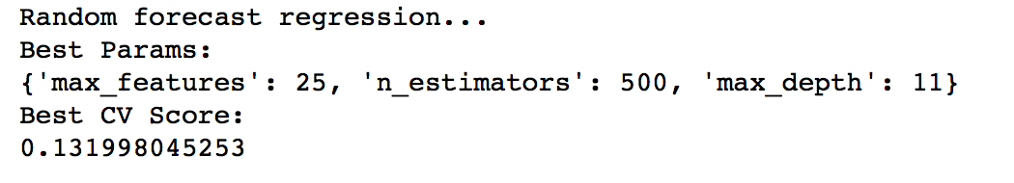
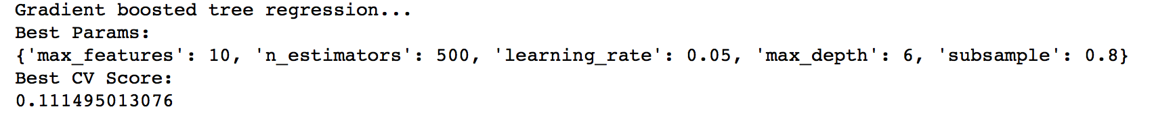
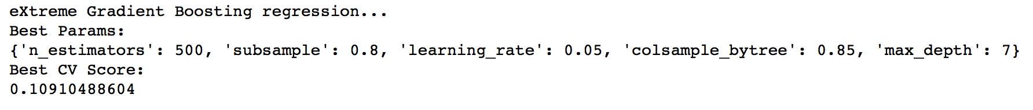
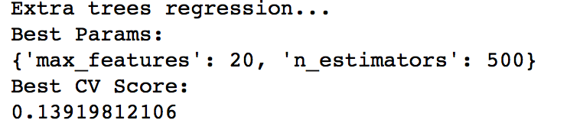
Single model
Figure 10: The local cross validation score for each base model after the grid search refinement.

Slide 16
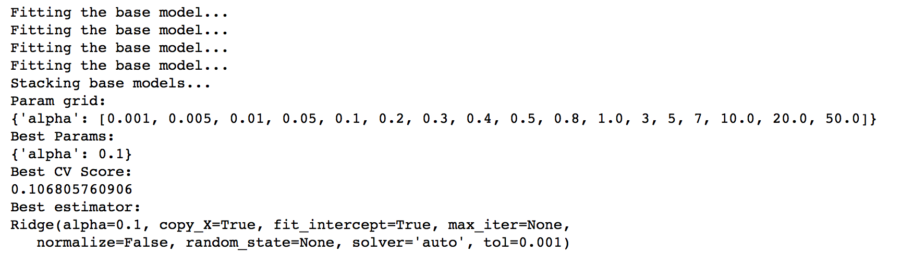
Ensemble models
I use the Ridge Regression as my second level model.
The idea of the stacking approach is to use the predictions from the first level model as the new features for the second level model and make prediction based on that.
Figure 11: The local cross validation score for ensemble models after the grid search refinement.
Notes:
The base models should be as unrelated as possible and this is why we tend to include more models in the ensemble even though they may not perform well. For my final, I use a much larger much library including Random Forest regressor, Extra Trees regressor, Gradient Boosting regressor, Extreme Gradient Boosting regressor, LassoCV regressor, K neighbors regressor, LassoLarsCV regressor, Elastic Net regressor, Support Vector Machine regressor. The Extreme Gradient Boosting regressor is from the XGBoost package, all other techniques are from scikit- learn package. The basic idea of the final model is to use a larger base model library in order to achieve better results. Some of the base models are used only with their scikit-learn default parameter values without fine tuning.
There are two challenging parts during the coding process. The first one is that we need to make sure the feature for the final second level prediction is based on the prediction of the first level base models. Thus, we also need to use the model prediction as the features for the test dataset. The second one is how exactly should we choose the base models. This is a tricky and not fully addressed question in this project since there are so many models to select. But the rule of thumb in my investigation is that I choose the one that improve the local score with the assumption that the local and public score has a good correlation.

Slide 17
Improvement
One part is for data preprocessing. Such as more advanced outlier detection techniques, more advanced feature selection techniques, fine tuning of the log transform threshold of the skewed variable and so on. More creative feature engineering will be also extremely useful.
Another part is for the regression techniques. My intuition for ensemble learning technique is that a better score may be achieved by increasing the size of the model library.

